Slide 1
將購物年金融入生活
Daily Life with the Shopping Annuity™
Margaret Chan
總顧問經理級 National Supervising Coordinator
四個佣金週期共賺取HK$76,600
HK$76,600 in 4 Commission weeks
本簡報中提到的收入等級純屬舉例說明，無意代表美安香港超連鎖™店主的一般收入，也無意表示任何超連鎖™店主皆可賺取同等收入。美安香港超連鎖™店主的成功與否，取決於其在發展事業時的努力、才能與投入程度。The income levels mentioned in the following presentation are for illustration purposes only. They are not intended to represent the income of a typical Market Hong Kong UnFranchise ™Owner, nor are they intended to represent that any given Independent UnFranchise ™ Owner will earn income in that amount. The success of any Market Hong Kong Independent UnFranchise ™ Owner will depend upon the amount of hard work, talent, and dedication which he or she devotes to building his or her Market Hong Kong Business.

Slide 2
甚麼是年金What is an Annuity
「年金」是指你在等額、定期的系列收支。An “Annuity” is a process by which a fixed payment is made to you at specified intervals for a specified length of time.
建立「年金」時，你必須在有收支前先投入一筆固定的資金。To fund the “Annuity” you must contribute a fixed sum payment before payouts to you may begin.
Notes:
TRAINERS NOTES:
Again, this is a popular investment and/or retirement strategy.
The benefit is that by paying into your annuity over time, you can expect to be paid back payments at retirement in monthly, quarterly, yearly or even lump sum payments based on your specific arrangements.
The downfall is that in order to fund the annuity, you need discretionary income to pay into it with. Most Americans have little to no discretionary income, therefore, cannot participate in an annuity program as part of their retirement strategy.

Slide 3
甚麼是購物年金 ？
What is Shopping Annuity?
美安香港的「年金」和普通的「年金」大致相同，但最大的分別是超連鎖™店主要先投入的並不是資金，而是︰
投入時間
改變購物習慣
Market Hong Kong’s Shopping Annuity is more or less the same as the concept of annuity, but the main difference is that UnFranchise™ Owners do not need to inject huge amount of capital. All you need to do first is:
Commit Your Time
Change Your Shopping Habit
Notes:
TRAINERS NOTES:
The Shopping Annuity is a revolutionary concept which levels the playing field. Because of how it works, anyone can enjoy the same major benefits of an annuity (receiving income as a result of funding) but with One Major Difference!

Slide 4
投資收入Investment Income
儲蓄收入
Saving Interest
股市基金
Stocks &Funds
投資Investment
儲蓄Savings
銀行Bank
打工收入Salary
2至3年計劃
The 2-3 Year Plan
支出Spending
超連鎖™事業
UnFranchise™ Business
永續收入Ongoing Income
MPCP 管理業積紅利計劃

Slide 5
在今天的銀行匯率下，你有這麼多現金作出投資嗎？Will you have this cash invested in the bank at today’s rates ?
超連鎖™永續收入 UnFranchise™ Ongoing Income | 4%的投資法則Equivalent Investment earning at 4%
$4,600 / Month (經理級Executive coordinator/ 主管經理級Master) | $1,380,000
$34,500 / Month (專業經理級Professional coordinator) | $11,040,000
$76,600 / Month (總顧問經理級National supervising) | $24,512,000
$138,000 / Month (高級顧問經理級Director) | $44,850,000
$276,000 / Month ( 副總裁級Field Vice President) | $92,000,000
超連鎖™收入
UnFranchise™ Income
vs. 4%的投資法則
The 4% Rule Investment
Notes:
Celine:
Figures have been changed to HK amounts.
TRAINERS NOTES:
The 4% Rule is a popular investment-income strategy that says as long as you withdraw no more than 4% of your initial portfolio, adjusted for inflation, on an annual basis during your retirement years, you shouldn't run out of money.
Take a look at what it would take to create a $4,600/month payment to yourself at retirement, following this rule. It would take $450,000 in the bank! Would you have that money saved up by retirement?
Most Americans are living paycheck to paycheck with little to no savings. How will they get it done? The answer is that most won’t, and therefore will never have the 4% rule as a viable retirement option.
With Market America, you could create a $4,600 / month asset as an executive coordinator or master coordinator. And even more, after 2-3 years of following our proven plan you could create a residual income of $1,420,000 / year. That is the equivalent of living off of 4% of a $5MILLION asset in the bank!
Think even further – if you built the UnFranchise as a way to enjoy residual income because you didn’t have the savings to participate in the 4% rule, now you can create the savings and earn both – the Residual Income from your UnFranchise and the 4% off the income you save!

Slide 6
你本身已不斷消費You’re Already Spending It…
何不將你的消費轉為收入﹖
Why Not Convert Your Spending Into Earning?
Notes:
TRAINERS NOTES:
Again, we are hitting this point! You are not funding this Shopping Annuity with discretionary income, but with money you are already spending.
Everybody spends money to live. You can either find a way to make that money work for you or you can continue to do what you’re doing and everything stays the same.

Slide 7
定位Positioning
消費者Consumers(慳＄Save$)
經營Running Business(賺＄Earn$)
規劃消費 ～ 購物年金評量表
Planning Your Spending ~ Shopping Annuity Assessment

Slide 8
購物年金四步驟
4 Steps for Earning Shopping Annuity
轉換成獨家代理商品 (買東西)
所有消費透過HK.SHOP.COM 網站 (買東西)
讓10~15位顧客改變消費習慣 (分享買東西)
改善其中2名顧客的財務狀況 (教朋友在那裡買好東西)
Switch to use mhk exclusive products (Purchase)
Switch ALL your shopping to HK.SHOP.COM (Purchase)
Make 10~15 customers change their shopping habit (Share)
Improve 2 customers’ financial status (Teach)

Slide 9
一般人想做的購物年金
Most People Think this is the Way to Build Shopping Annuity
購物年金Build Shopping Annuity
零售 Start Retailing
有顧客Gather Customers
有團隊
Built their Team
招募
Recruiting
成功Success

Slide 10
事實上 (註定失敗的做法)
The Way Doomed to Failure
無法經驗分享Cannot Share Experience
不做購物年金
Without Building Shopping Annuity
沒有顧客 No Customer
無法零售Cannot Make Sales
沒有名單
No Preferred List
招募不順 Difficulty with Recruiting
沒有發展
No Development
財務壓力
Financial pressure
負面情緒Negative Emotions
放 棄 Give Up

Slide 11
註定成功的系統
Follow the System with Proven Success
做購物年金
Build Your Shopping Annuity
經驗分享 Share Experience
服務顧客
Serve Your Customers
成功零售 Succeed in Retails
建立形象 Develop Your Image
吸引人才 Attract Potential Partners
成 功Success
發展通路Develop Channels
團隊合作
Team Work
複製經驗 Duplication

Slide 12
在今天的銀行匯率下，你有這麼多現金作出投資嗎？Will you have this cash invested in the bank at today’s rates ?
超連鎖™永續收入 UnFranchise™ Ongoing Income | 4%的投資法則Equivalent Investment earning at 4%
$4,600 / Month (經理級Executive coordinator/ 主管經理級Master) | $1,380,000
$34,500 / Month (專業經理級Professional coordinator) | $11,040,000
$76,600 / Month (總顧問經理級National supervising) | $24,512,000
$138,000 / Month (高級顧問經理級Director) | $44,850,000
$276,000 / Month ( 副總裁級Field Vice President) | $92,000,000
超連鎖™收入
UnFranchise™ Income
vs. 4%的投資法則
The 4% Rule Investment
Notes:
Celine:
Figures have been changed to HK amounts.
TRAINERS NOTES:
The 4% Rule is a popular investment-income strategy that says as long as you withdraw no more than 4% of your initial portfolio, adjusted for inflation, on an annual basis during your retirement years, you shouldn't run out of money.
Take a look at what it would take to create a $4,600/month payment to yourself at retirement, following this rule. It would take $450,000 in the bank! Would you have that money saved up by retirement?
Most Americans are living paycheck to paycheck with little to no savings. How will they get it done? The answer is that most won’t, and therefore will never have the 4% rule as a viable retirement option.
With Market America, you could create a $4,600 / month asset as an executive coordinator or master coordinator. And even more, after 2-3 years of following our proven plan you could create a residual income of $1,420,000 / year. That is the equivalent of living off of 4% of a $5MILLION asset in the bank!
Think even further – if you built the UnFranchise as a way to enjoy residual income because you didn’t have the savings to participate in the 4% rule, now you can create the savings and earn both – the Residual Income from your UnFranchise and the 4% off the income you save!

Slide 13
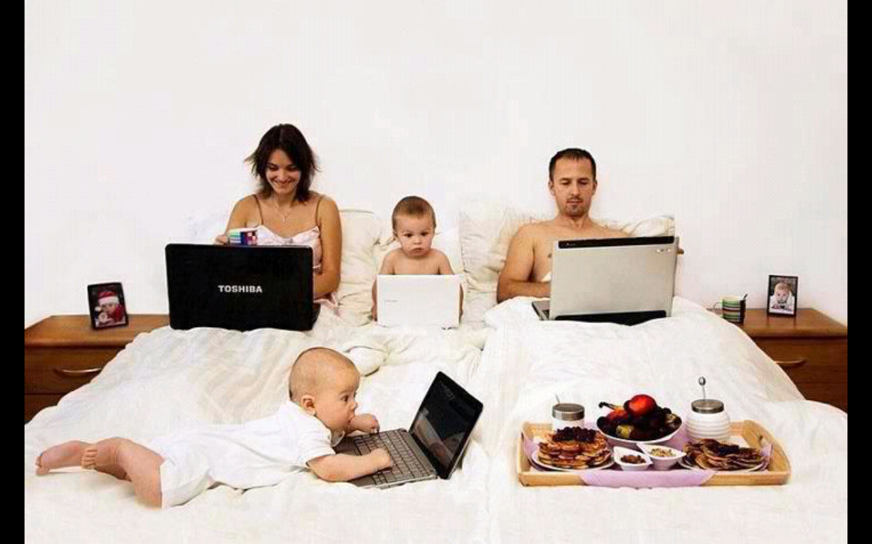
習慣Habit

